Slide 1
Memory and Storage
Presented by
Syed Shakil Mahmud
Lecturer
Department of Computer Science and Engineering
Bangladesh Army International University of Science and Technology

Slide 2

Introduction to Memory
Storage Capacity
Outlines
Types of Memory
Classification of Memory and Storage
Types of Main Memory

Slide 3

What is a Memory?

Slide 4
What is a Memory?
Computer memory is just like the human brain. It is used to store data/information and instructions.
Computer memory is any physical device capable of storing information temporarily, like RAM (random-access memory), or permanently, like ROM (read-only memory).
It is a data storage unit or a data storage device where data is to be processed and instructions required for processing are stored.

Slide 5
Units of Memory
Memory units are the amount of data that a memory device can store. Here are some units of memory:
Bit: A bit is the smallest unit of measurement of data. The first memory location in a computer is a bit. Represents binary values 0 and 1.
Nibble: It means the group of 4 bits.
Word: A word is a unit of data in computer architecture that can be moved between a computer's processor and storage. The number of bits in a word is known as the word size, word length, or word width. A word consists 16 bit.
Byte: The fundamental unit used to measure data is the byte. It has 8 bits in it. A byte can therefore represent 2 ^ 8 or 256 values.

Slide 6
Units of Memory
Kilobyte (KB):1024 bytes is equal to one kilobyte. 1KB = 2^10 Byte
Megabyte(MB): A megabyte is 1024 kilobytes in size. It contains more info as compared to a kilobyte. 1MB = 2^20 Byte
Gigabyte (GB): A megabyte is 1024 kilobytes in size. It contains more info as compared to a kilobyte. 1GB = 2^30 Byte
Terabyte (TB): A terabyte is made up of 1024 gigabytes. 1TB = 2^40 Byte
Petabyte (PB): A petabyte is made up of 1024 terabytes.

Slide 7
Units of Memory
Exabyte (EB): Equal to 1024 petabytes.
Zettabyte (ZB): Equal to 1024 exabytes.
Yottabyte (YB): Equal to 1024 zettabyte.

Slide 8
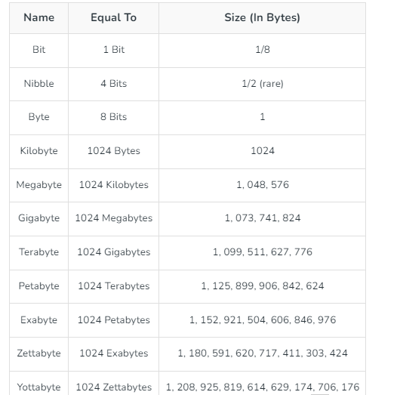
Conversion of Units

Slide 9
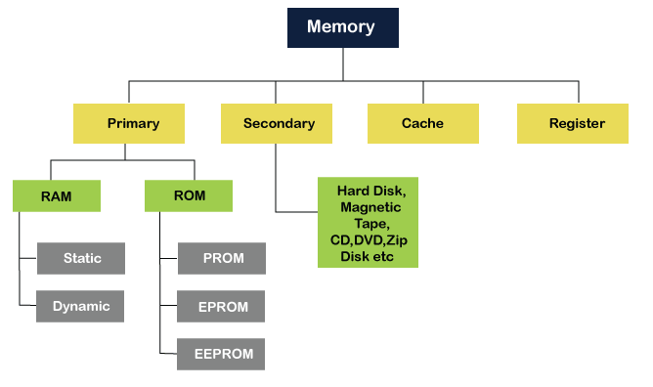
Types of Memory

Slide 10
Primary Memory
Primary memory is also known as the computer system's main memory that communicates directly within the CPU, Auxiliary memory, and Cache memory.
Main memory is used to keep programs or data when the processor is active to use them.
When a program or data is activated to execute, the processor first loads instructions or programs from secondary memory into main memory, and then the processor starts execution.
The primary memory is further divided into two parts:
RAM (Random Access Memory)
ROM (Read Only Memory)

Slide 11
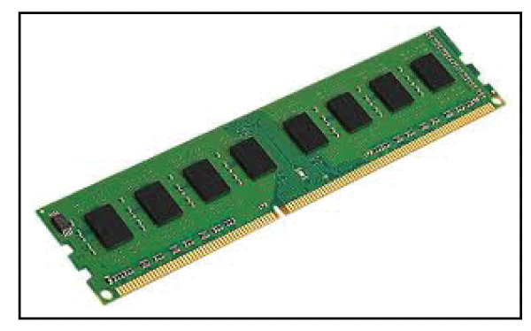
Primary Memory: RAM
Random Access Memory (RAM) is one of the faster types of main memory accessed directly by the CPU.
It is the hardware in a computer device to temporarily store data, programs or program results.
It is used to read/write data in memory until the machine is working.
It is volatile, which means if a power failure occurs or the computer is turned off, the information stored in RAM will be lost.
All data stored in computer memory can be read or accessed randomly at any time.

Slide 12
Primary Memory: RAM
There are two types of RAM:
SRAM: SRMA (Static Random-Access Memory) is a type of RAM used to store static data in the memory. It means that storing data in SRAM remains active as long as the computer system has a power supply. However, data is lost in SRAM when power failures have occurred. The size of the capacitor and the transistor is so small, requiring millions of them to store on a single chip
DRAM: DRAM (Dynamic Random-Access Memory) is a type of RAM that is used for the dynamic storage of data in RAM. In DRAM, each cell carries one-bit information. The cell is made up of two parts: a capacitor and a transistor.

Slide 13
Primary Memory: ROM
ROM or Read Only Memory is a memory device or storage medium that is used to permanently store information inside a chip.
It is a read-only memory that can only read stored information, data, or programs, but we cannot write or modify anything.
A ROM contains some important instructions or program data that are required to start or boot a computer.
It is a non-volatile memory; which means that the stored information cannot be lost even when the power is turned off or the system is shut down.

Slide 14
Primary Memory: ROM
Types of ROM are:
MROM (Masked Read Only Memory)
PROM (Programmable Read Only Memory)
EPROM (Erasable and Programmable Read Only Memory)
EEPROM (Electrically Erasable and Programmable Read Only Memory)
Flash ROM

Slide 15
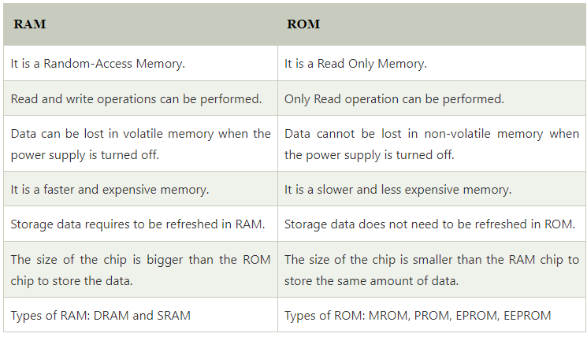
RAM vs ROM

Slide 16
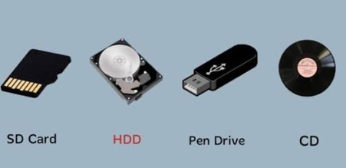
Secondary Memory
Secondary memory is a permanent storage space to hold a large amount of data.
Secondary memory is also known as external memory which represents the various storage media (hard drives, USB, CDs, flash drives, and DVDs) on which the computer data and program can be saved on a long-term basis.
However, it is cheaper and slower than the main memory.

Slide 17
Secondary Memory
Unlike primary memory, secondary memory cannot be accessed directly by the CPU.
Instead of that, secondary memory data is first loaded into the RAM (Random Access Memory) and then sent to the processor to read and update the data.
Secondary memory devices also include magnetic disks like hard disks and floppy disks, an optical disk such as CDs and CDROMs, and magnetic tapes.

Slide 18
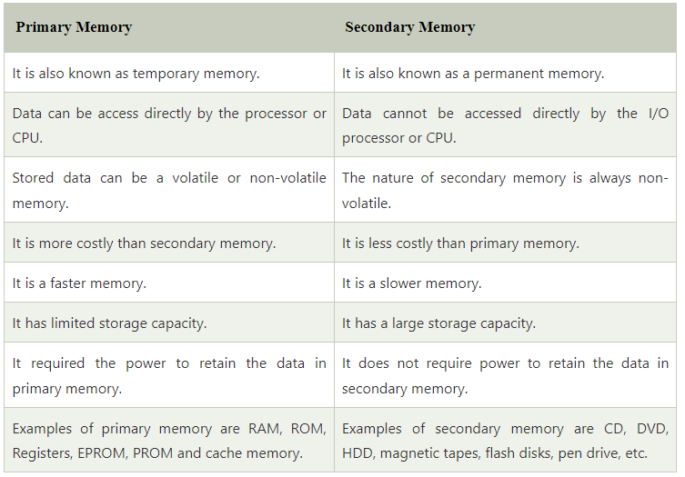
Secondary Memory vs Primary Memory

Slide 19
Cache Memory
It is a small-sized chip-based computer memory that lies between the CPU and the main memory.
It is a faster, high-performance, and temporary memory to enhance the performance of the CPU.
It stores all the data and instructions that are often used by computer CPUs.
It also reduces the access time of data from the main memory.
It is faster than the main memory

Slide 20
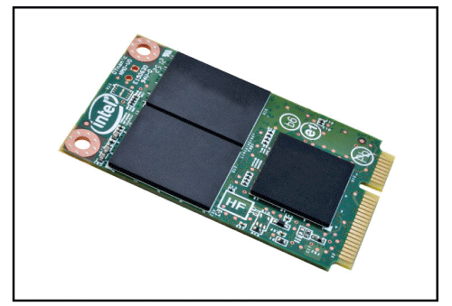
Cache Memory
Cache memory is divided into three levels: L1, L2, and L3.
L1 cache is the fastest but smallest,
L2 cache is slower but bigger, and
L3 cache is the slowest but biggest. L3 cache is designed to optimize the performance of L1 and L2 cache and is the largest type of cache memory with a capacity of 1MB to 8MB.

Slide 21
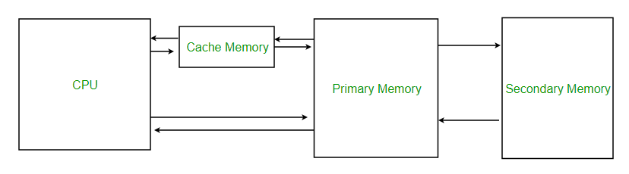

Slide 22
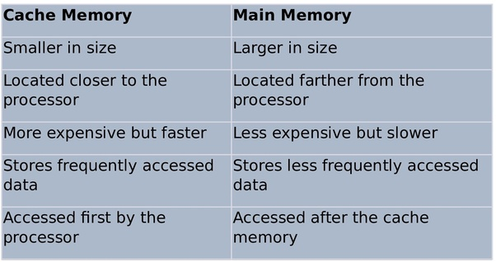
Cache Memory vs Main Memory

Slide 23
Register Memory
The register memory is a temporary storage area for storing and transferring the data and the instructions to a computer.
It is the smallest and fastest memory of a computer.
It is a part of computer memory located in the CPU as the form of registers.
The register memory is 16, 32 and 64 bits in size.
It temporarily stores data, instructions and the address of the memory that is repeatedly used to provide faster response to the CPU.

Slide 24
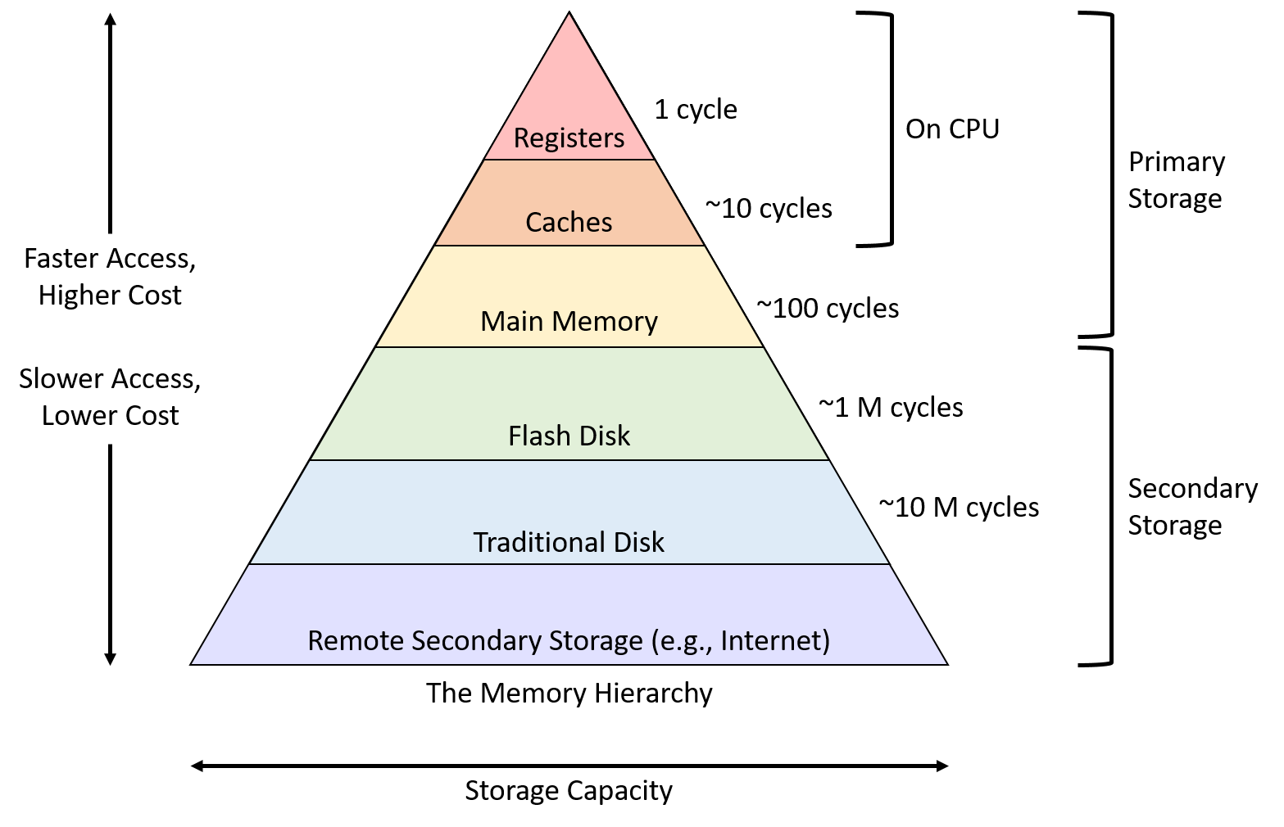
Memory Hierarchy

Slide 25

Any Questions?

Slide 26
Thank You

